Slide 1


Cache Simulator
Phillip Driscoll
Dickson Houmbie

Slide 2
Index
Overview
Design Decisions
Build System
Input Verification
Simulator Logic
Functions
Address Partitioning
Build and Test Scripts
Results
Memory Leak Detection
Problems
Conclusion

Slide 3
Overview
Building a cache simulator to verify the state of cache and memory
Memory traces used to debug software
Verification of memory state
Ensure no memory corruption
Easily verify cache statistics
Helpful to discover potential performance gains
Notes:
Here, we’re presenting a cache simulator project that is designed to verify the state of cache and memory in a system.
This simulator works with memory traces to debug software, ensuring the accuracy and integrity of memory states. A key goal is to prevent memory corruption by enabling easy verification of cache statistics and operations.
Beyond ensuring correctness, this tool helps in performance optimization, helping developers identify opportunities to enhance speed and efficiency. By doing this, we aim to make debugging and performance tuning more straightforward.

Slide 4
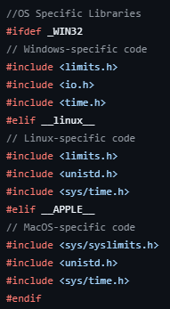
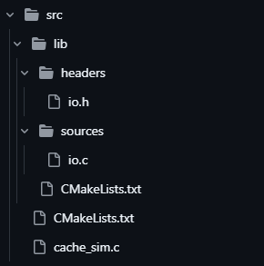
Design Decisions
Use the C programming language
Genuine hate for the JVM
Fast
Apt considering the low-level nature of the project
IO library holding all essential cache functionality
Built-in benchmarking functionality
Support for different cache / memory architectures
MacOS, Linux, Windows support
Notes:
When it comes to design decisions, this simulator is built using C. Now, why? First, C’s low-level nature aligns perfectly with the project’s needs, offering both speed and control.
Another reason? Philip genuinely dislike the JVM! For this project, using C allows to avoid overhead entirely.
An I/O library was implemented to contain all essential cache functionality, and we incorporated built-in benchmarking to analyze performance.
Additionally, the simulator supports a range of cache and memory architectures, and runs across major platforms, including MacOS, Linux, and Windows, to ensure versatility.

Slide 5
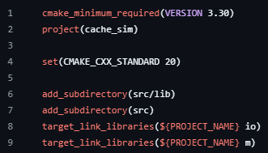
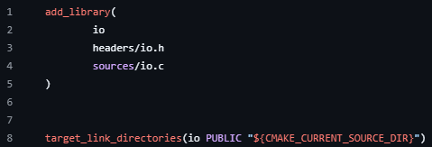
Build System
Cmake
CMakeLists.txt for project, main program file, and library files
Easy to specify compiler and build system requirements
Linking libraries becomes easier
Notes:
To streamline the build process, we used Cmake, which simplifies project configuration and management.
Our CMakeLists.txt files are structured to handle the main program file, library files, and overall project setup. This structure makes it easier to define compiler settings and specify build requirements.
CMake also simplifies linking libraries, which is essential for a project like this that involves multiple dependencies.

Slide 6
Input Verification
User input verification
Program parameter flag check
Flag option validity check
File input verification
Verify input file existence
Verify all trace lines from the input file
We want to ensure that all of our inputs are correct since we want to prevent any and all undefined behavior since it can result in memory leaks
Notes:
In addition to that, we have the Input Verification, which is a crucial part of our simulator.
We verify user inputs, including program parameter flags, to ensure they’re valid. We also perform a thorough flag option check and validate the existence and contents of inputs files.
For example, every trace line in the input file is validated to prevent potential errors during simulation.
The goal here is to eliminate any undefined behavior, which can lead to memory leaks or other issues. By enforcing strict input verification, we ensure that the simulator operates reliably and as intended.

Slide 7
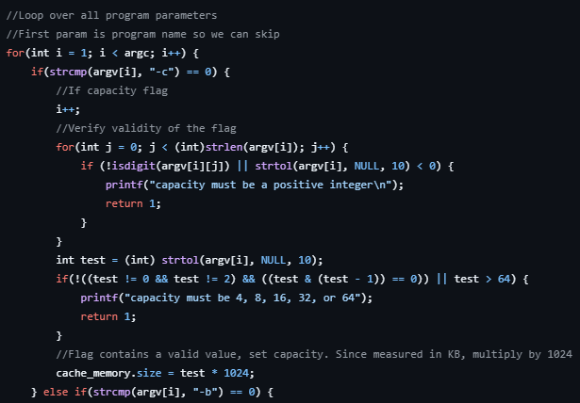
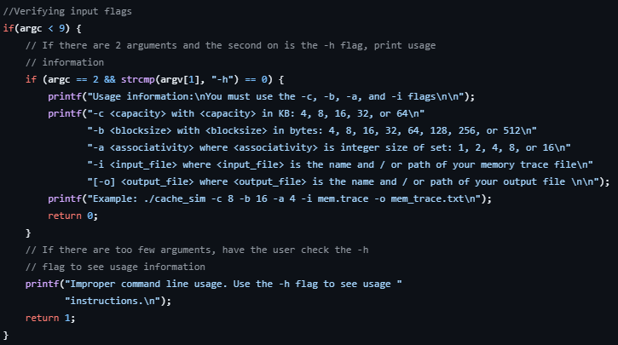
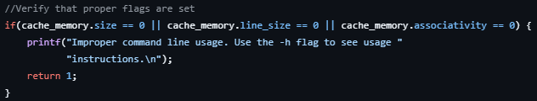
User Input Verification
Notes:
The checks if the user entered the correct inputs when running a program. It ensures all required settings (lie size and type) are valid, gives instructions if something is missing or wrong, and stops the program if the inputs are invalid.

Slide 8
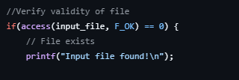
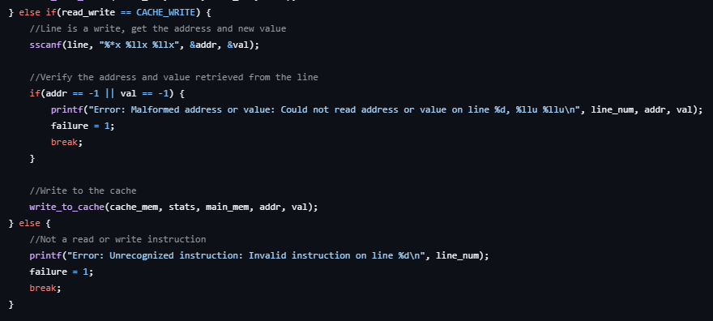
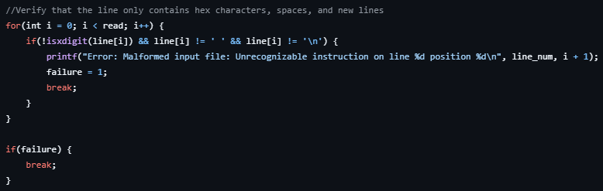
File Input Verification
Notes:
The code checks a file provided by the user to make sure it exists, is readable, and contains valid data. If anything is wrong, it reports the issue and stops further processing

Slide 9
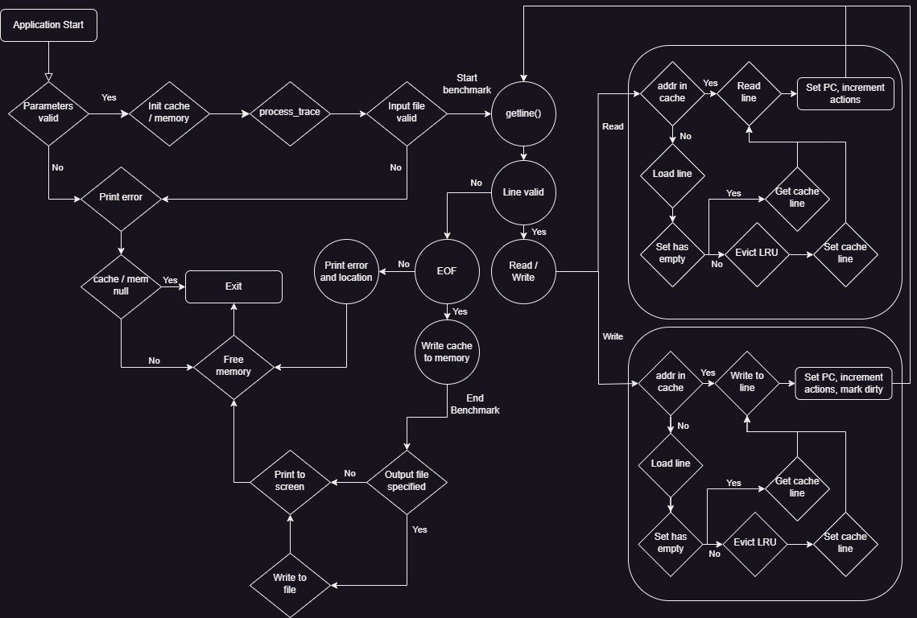
Simulator Logic

Slide 10
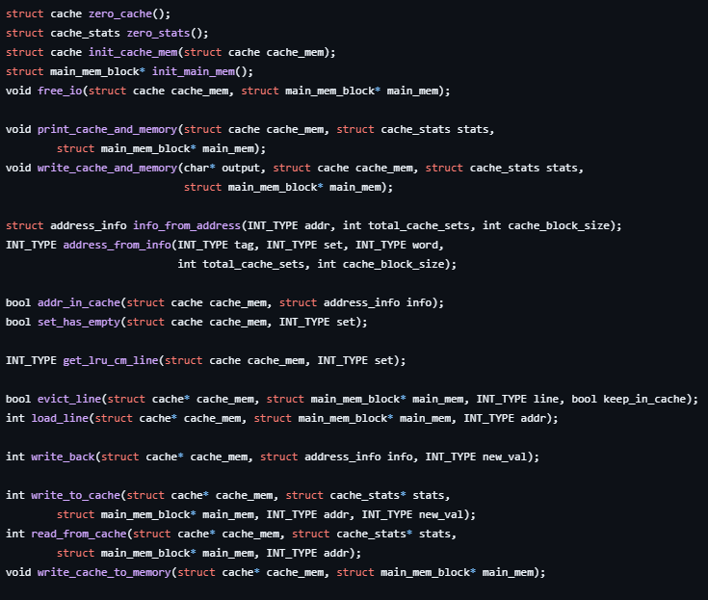
Functions
Most functions lie in IO library
For configuring cache
Main cache_sim.c file for verifying
input and reading trace lines

Slide 11
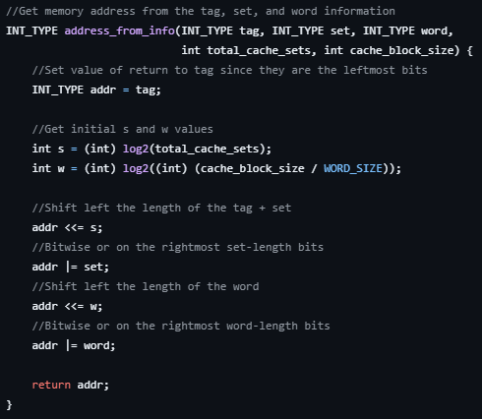
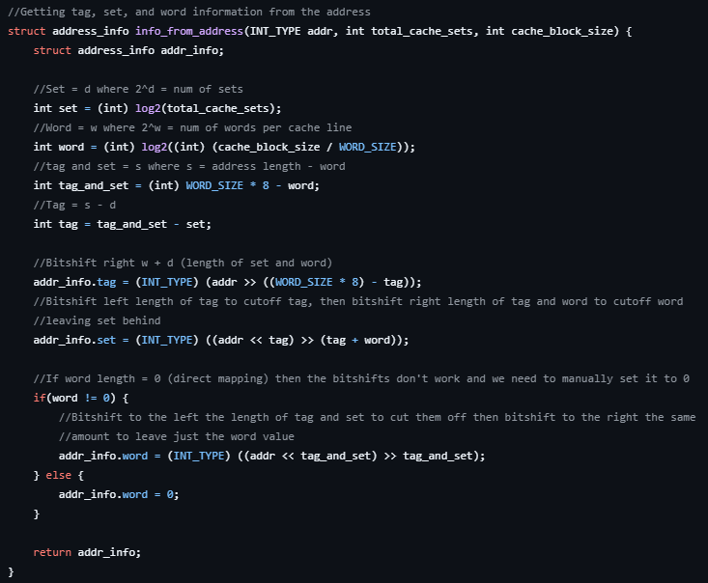
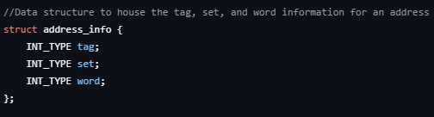
Address Partitioning

Slide 12
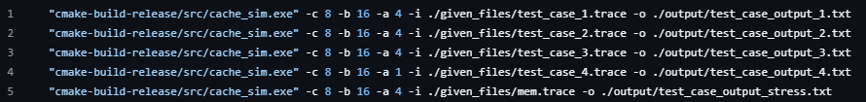
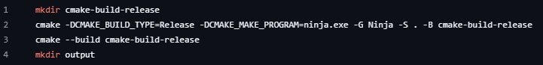
Build and Test Scripts
Script to build the project with Cmake
Cmake, Ninja, and a C compiler are necessary
Test script uses the test case traces and the mem.trace file and process them
automatically

Slide 13
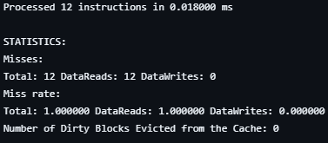
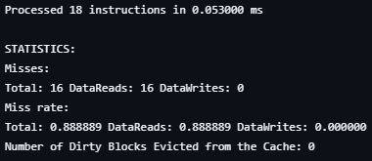
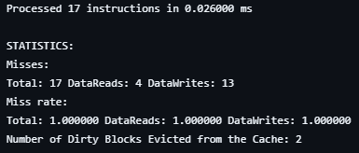
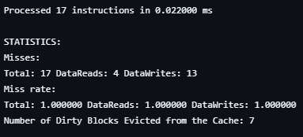
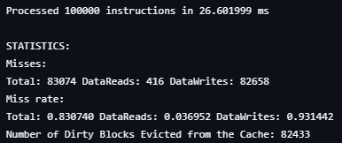
Results
Test Case 1
Test Case 2
Test Case 3
Test Case 4
Stress Test

Slide 14
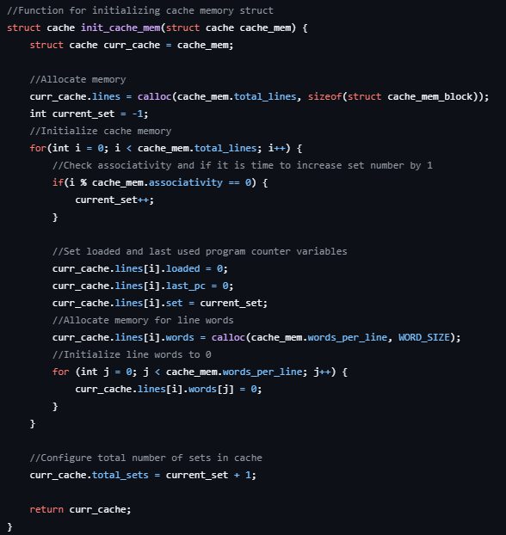
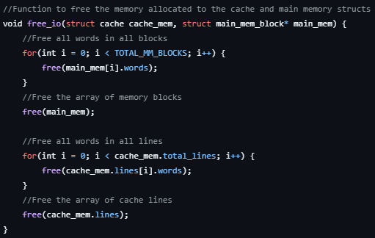
Memory Leak Detection
C likes to leak memory
Our simulator allocates a lot of memory
Must free memory before program exit
Valgrind can detect memory leaks
Only works on Linux

Slide 15
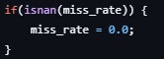
Problems
Building for MacOS, Linux, and Windows
Pointer referencing in functions
32-bit maximums as cache input values from mem.trace
Eviction vs. dirty eviction
NaN values for (float) 0.0 / (float) 0.0
Math library linkage errors

Slide 16
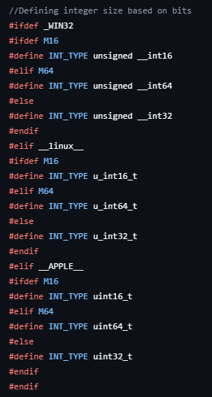
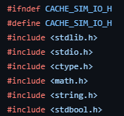
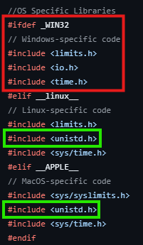
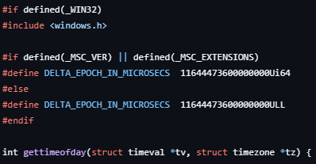
OS Specific Issues
The lack of unistd.h in Windows is the bane of my existence

Slide 17
Conclusion
Fun and interesting project
Taught us about algorithmically determining cache / memory location
Interesting to see how the cache handles evictions
Capacity, block size, and associativity can make a big impact on cache performance

